Slide 1

PARS: Optimizing High-Dimensional Vector Search with Dimensional Reduction and Ray Tracing Core
Yiling Ma†, Mengbai Xiao†,‡, Zhixiong Xiao†, Yuan Yuan†, Dongxiao Yu†, Guanghui Zhang†, Feng Li†
† Shandong University, China
‡ Shandong Provincial Key Laboratory of Computing-Network Integration, China
June 24, 2026
Seoul, South Korea
Notes:
Hi everyone, my name is Yiling. Today I’m happy to present PARS: optimizing high-dimensional vector search with dimensional reduction and RT Core.
The authors are from Shandong University.

Slide 2



Vector Search is Important
How to find the right information?
Raw data
Embedding
High-dimensional vector
Large-scale data repositories
Vector search
AI generation
Notes:
- Multimedia and unstructured data are growing very fast. The data grows much faster than our ability to organize or label it.
- So the challenge is no longer how to collect data. The real challenge is how to find the right information in a huge dataset.
- [click] Modern embedding models turn different types of data into vectors. These vectors keep the semantic meaning. To search them efficiently, we use vector search. It is now a key technology in many AI systems.
- Vector search finds the most relevant knowledge. Then RAG brings this knowledge into Large Language Model generation. In this way, [click] vector search works like a bridge. It connects large data repositories with knowledge-based AI generation.

Slide 3


ANN Search
Exact NN Search
Curse of dimensionality
Complexity is close to brute-force
ANN Search
Tolerate accuracy loss
High search throughput
Space partitioning, hashing, quantization, graph-based
Graph
Notes:
- Traditional nearest neighbor search uses spatial indexes to speed up retrieval.
- [click] But this becomes hard in high-dimensional spaces. This problem is known as the curse of dimensionality. As the dimension increases, these indexes become much less effective. In the end, the search can get close to brute-force scanning.
- [click] Approximate nearest neighbor search addresses this problem. It trades a small amount of accuracy for much better efficiency. Existing ANN methods mainly fall into four categories: space partitioning, hashing, quantization, and graph-based methods.
- [click] Graph-based methods usually give a good balance between accuracy and efficiency. So they are the main focus of this work.

Slide 4
Graph-based ANN Search
Related work on GPU:
GGNN
GANNS
CAGRA
query
NN
“GGNN: Graph-Based GPU Nearest Neighbor Search”, TBD’22
“GPU-accelerated Proximity Graph Approximate Nearest Neighbor Search and Construction”, ICDE’22
“CAGRA: Highly Parallel Graph Construction and Approximate Nearest Neighbor Search for GPUs”, ICDE’24
Notes:
- Graph-based search starts from an entry point. [click] Then it explores neighboring nodes.
- [click] At each step, we move to the neighbor that is closer to the query.
- [click] This process continues. Each step moves closer to the query. It stops when no better neighbor can be found.
- [click] The remaining candidates are then returned as the search results.
- In recent years, many graph-based ANN search algorithms have been proposed in both academia and industry. To further improve performance, many studies use GPUs to speed up graph traversal and distance computation.
- [click] Typical GPU-based methods include GGNN, GANNS, and CAGRA. They have greatly improved search throughput and latency.
- However, several challenges still remain.

Slide 5
Challange
Dimensionality Reduction
High memory access cost
High memory usage
The distance calculation incurs high cost
Need an efficient solution for searching for entry points
Each time, read fewer bytes
Store smaller vectors
Fewer floating-point calculations
Use the first few dimensions to search the entry points
Notes:
Some of the key challenges include:
- For high-dimensional vectors, each access needs more dimensions. This brings a large memory overhead.
- [click] Graph indexes contain both graph topology and original data points. When the dataset is large, they take a lot of GPU memory.
- [click] Another challenge is computation cost. High-dimensional vectors need many distance calculations. This increases latency.
- [click] The starting point is also important. A good entry point helps the search converge faster. It also lowers the risk of getting stuck in a local optimum.
In this study, we propose using [click] dimensionality reduction to address these issues.
[click] Dimensionality reduction helps in several ways. It reduces memory access. It lowers storage cost. It speeds up distance computation. It also helps us find better entry points.

Slide 6
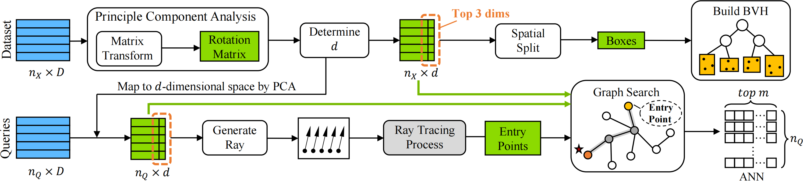
Research Idea
Reduce the data dimension.
Perform the entry point search using first 3 dimensions by RT Core.
Design the twin-buffer to dynamically load full-precision vectors.
Twin-buffer
Notes:
So we propose a new ANN search framework called PARS.
- [click] First, we choose a suitable target dimension by sampling. Then we use PCA to reduce the data dimension. The reduced dataset can still work with the existing graph index structure.
- [click] Next, we use the first three PCA dimensions to build a ray-tracing scene. Then we use RT Core to search for the entry point.
- [click] Finally, to make up for the accuracy loss from dimensionality reduction, we design an optional module called twin-buffer. It can dynamically load full-precision vectors. It is useful when high accuracy is required.

Slide 7
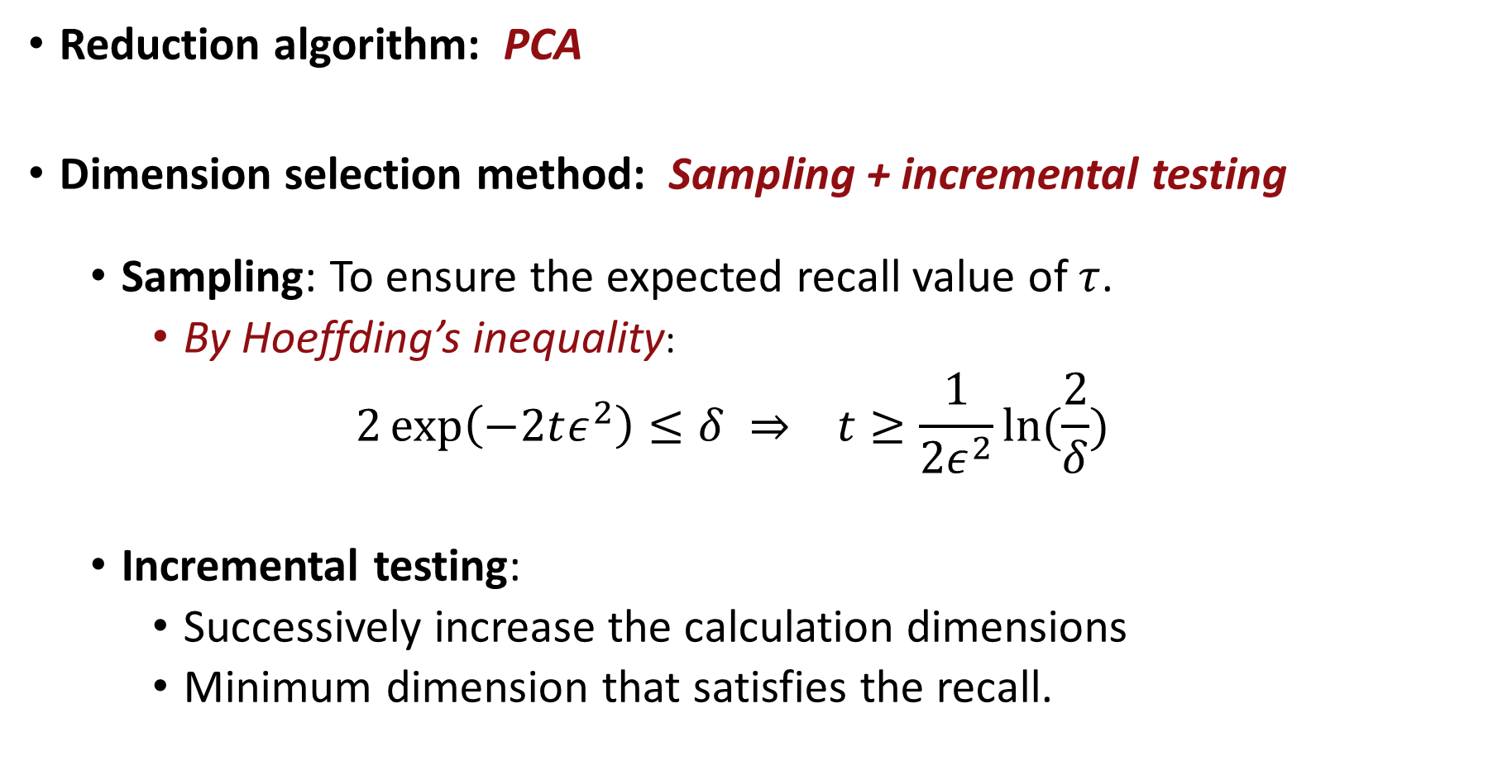
Dimensionality Reduction
Reduction algorithm: PCA
Dimension selection method: Sampling + incremental testing
  Sampling: To ensure the expected recall value of $τ$.
    By Hoeffding’s inequality:
  $$2\exp\left(−2tε^{2}\right)≤δ ⇒ t≥\frac{1}{2ε^{2}}ln⁡(\frac{2}{δ})$$
  Incremental testing:
    Successively increase the calculation dimensions
    Minimum dimension that satisfies the recall.
Notes:
- In the dimensionality reduction stage, we use PCA because it can keep most of the information while reducing the dimension.
- [click] To choose the target dimension, we first sample a subset of queries using Hoeffding’s inequality. Then we gradually increase the dimension until we reach the target recall.

Slide 8



Dimensionality Reduction
Reduction algorithm: PCA
Dimension selection method: Sampling + incremental testing
  Sampling: To ensure the expected recall value of $τ$.
    By Hoeffding’s inequality:
  $$2\exp\left(−2tε^{2}\right)≤δ ⇒ t≥\frac{1}{2ε^{2}}ln⁡(\frac{2}{δ})$$
  Incremental testing:
    Successively increase the calculation dimensions
    Minimum dimension that satisfies the recall.
Target recall：$τ=97\%$
Confidence level：$α=95\%$
Tolerance：$ε=0.02$
$$t≥\frac{1}{2ε^{2}}\ln\left(\frac{2}{δ}\right) = 4616$$
Notes:
- With a target recall of ninety-seven percent, ninety-five percent confidence, and a tolerance of zero point zero two, the required sample size is four thousand six hundred and sixteen.

Slide 9
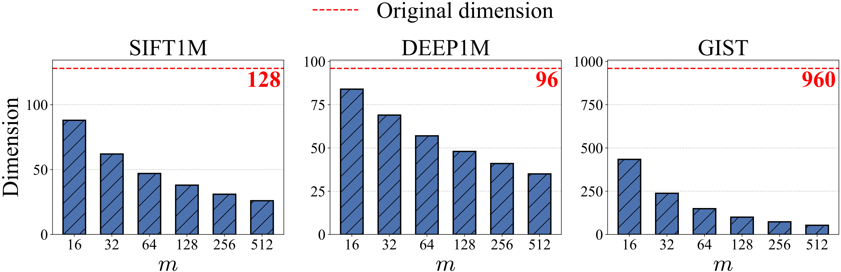
Dimensionality Reduction
Different Datasets Can Significantly Reduce the Dimensionality.
Notes:
- The test results show that we can greatly reduce the dimension on different datasets. At the same time, the recall still meets the theoretical lower bound.

Slide 10
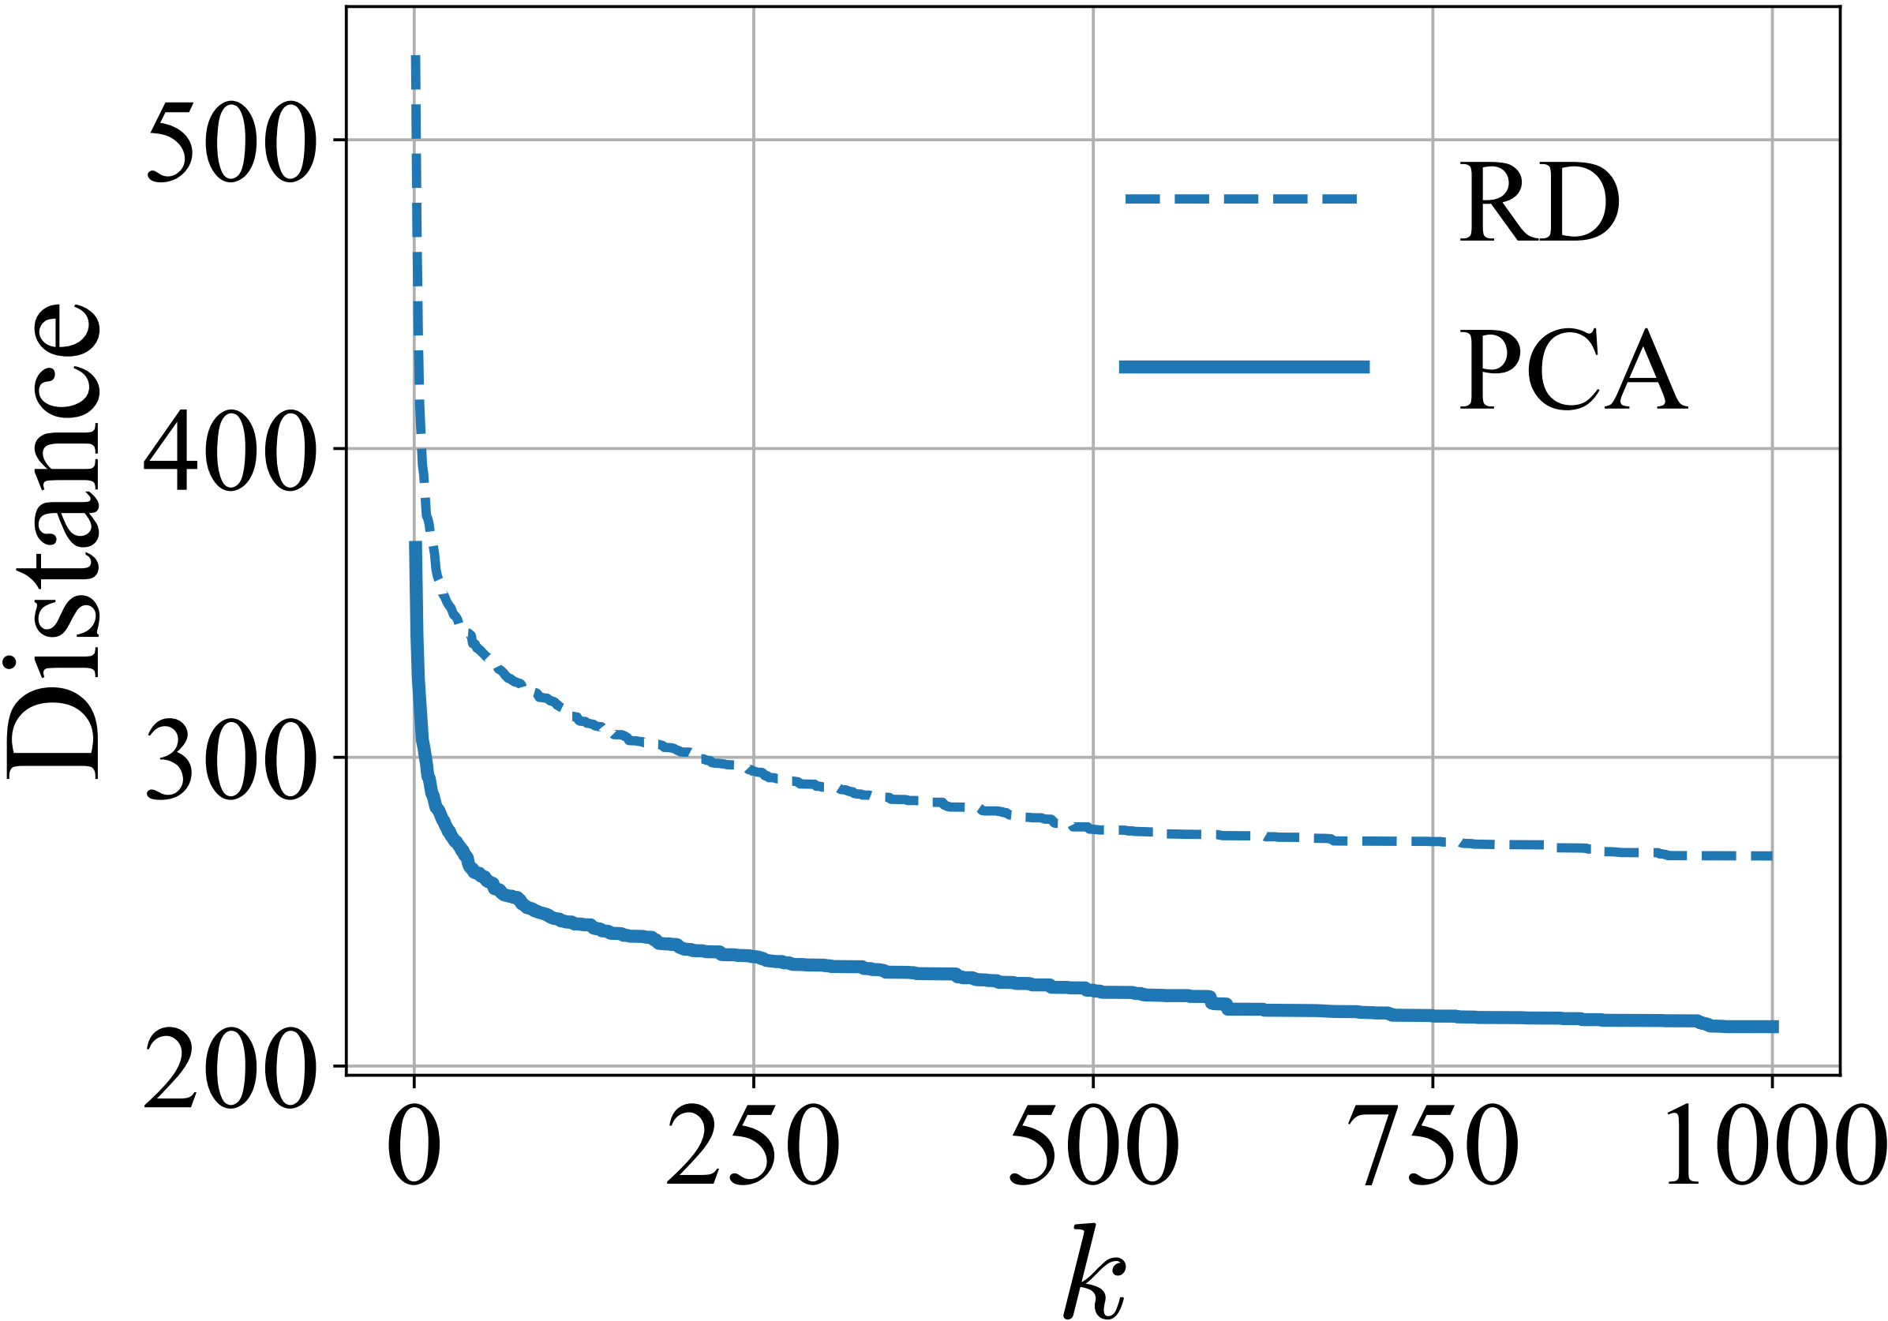
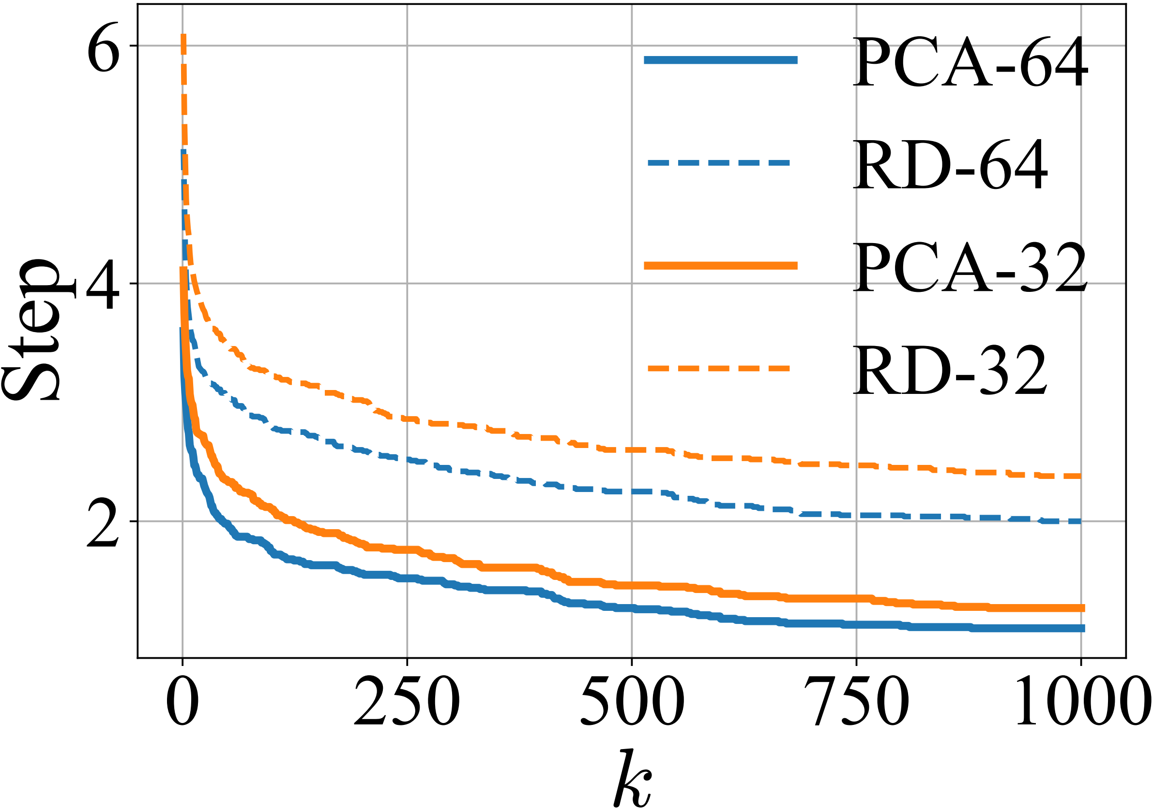
3D-Based Entry Point Selection
Better entry point
Better result & Quickly converge
How about using top-3 PCA dimensions?
3D-Based Entry Point Selection is Effective
Closer to the target point and requiring fewer hops
Notes:
- In graph-based search, a good entry point can help the search converge faster. It can also reduce the chance of getting stuck in a local optimum.
- [click] So, what if we use the top three PCA dimensions to choose this entry point?
- [click] In our preliminary experiments, we compared two types of entry points. One was selected using the first three reduced dimensions. The other was randomly selected.
- The results show that the entry points from the first three dimensions are closer to the true nearest neighbors. They also need fewer hops to reach them.
- [click] This shows that the first three dimensions are useful for entry point selection.

Slide 11
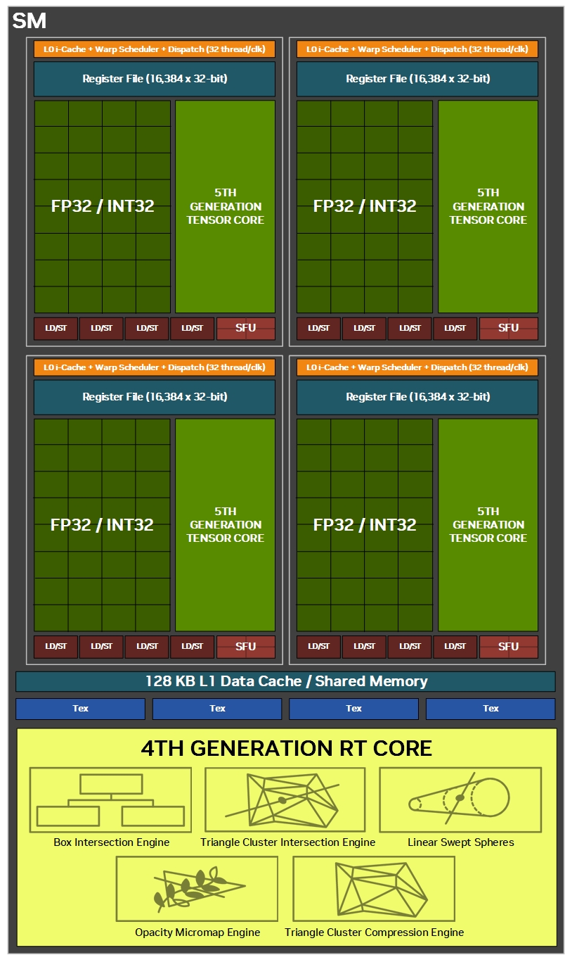
RT Core Acceleration
Construct BVH for scene
Perform intersection testing
RT Core
Notes:
- Nearest neighbor search in the reduced three-dimensional space can be treated as a ray-tracing problem. This allows us to use RT Cores to speed up the computation.
- [click] RT Cores are dedicated hardware units on GPUs. They are designed for ray tracing.
- [click] They speed up ray-tracing operations and build BVH indexes for the scene. This reduces unnecessary intersection tests. RT Core can also perform intersection testing directly in hardware.

Slide 12
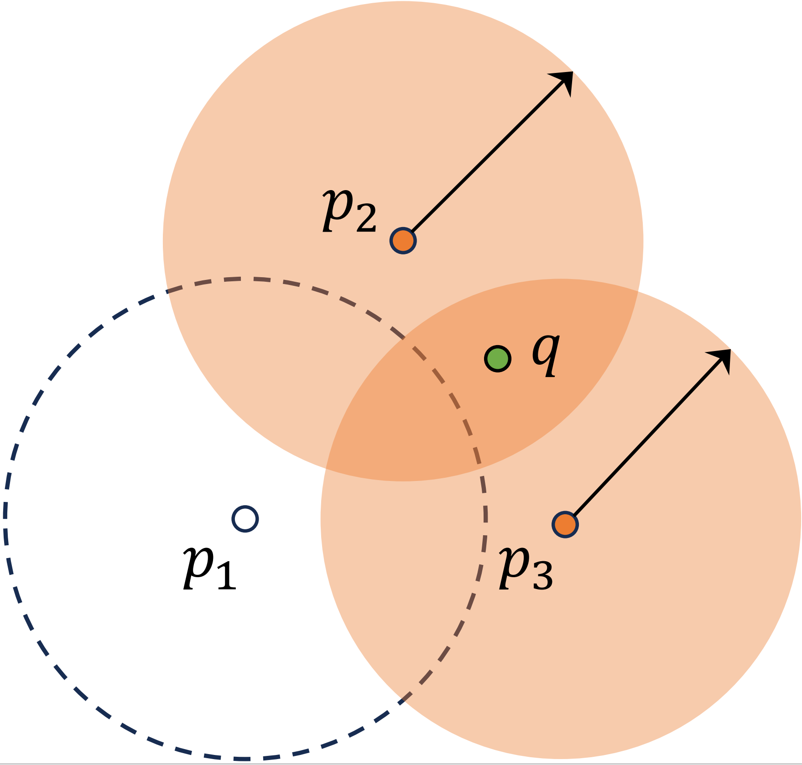
RT Core Acceleration
Create a primitive for each data point
Construct Sphere Primitives
Large Dataset
Too many primitives
Memory usage
“RTNN: accelerating neighbor search using hardware ray tracing”, PPoPP’22
Notes:
- An existing method, RTNN, models each point as a sphere. It emits a very short ray from the query point. Then it uses RT Cores to find the spheres that are intersected.
- [click] But for large-scale datasets, this creates a very large BVH structure. It also uses a lot of memory.

Slide 13
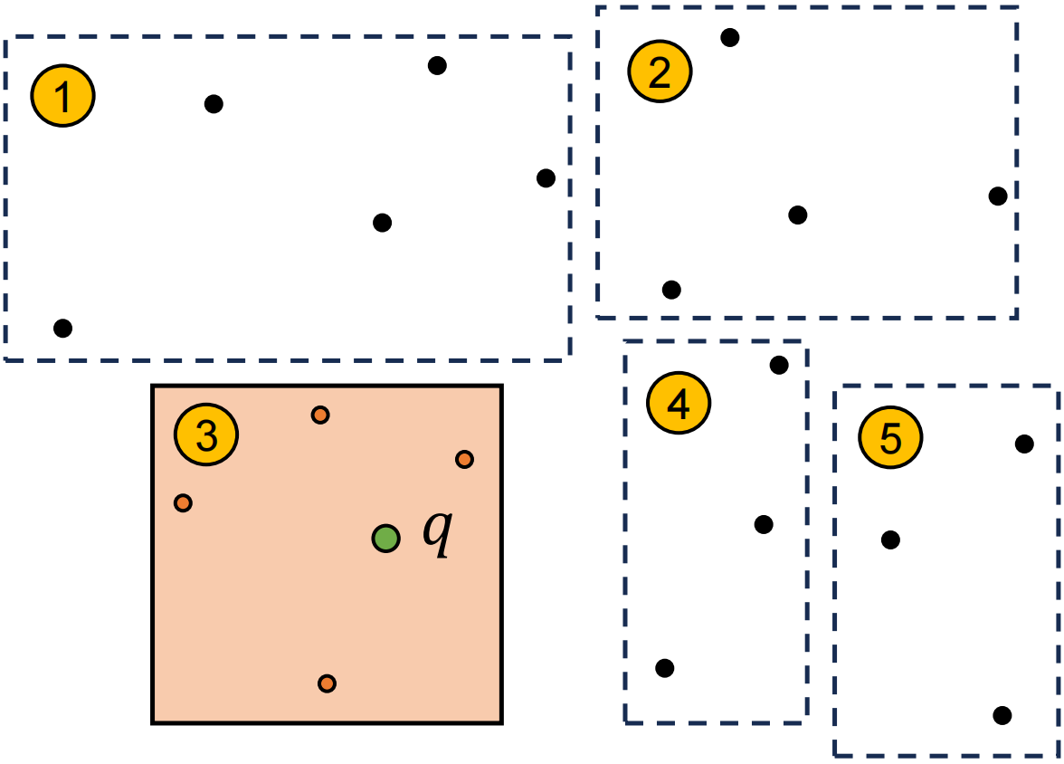
RT Core Acceleration
Construct Sphere Primitives
Space Partition
Axis-Aligned Bounding Box
(AABB)
Notes:
- To solve this problem, we propose a new modeling approach. First, we partition the dataset into several regions. Then we build an AABB for each partition.
This is because the RT Core hardware supports AABB, spheres, and triangles as primitives. Moreover, in order to ensure that the divided areas cover all the points in the scene and minimize the overlap between the areas, we chose to use rectangles, which are also AABBs, as the primitives.

Slide 14

RT Core Acceleration
1
2
Set the maximum AABB size to 5
4
3
5
Recursive partitioning
$$q$$
Notes:
- We recursively [click] partition the space along the longest [click] axis until each partition contains only a few points [click].
- An AABB is then built for each partition.
- During search, [click] we find the closest AABB. Then we use the points inside it as graph entry points.

Slide 15

Twin-buffer
Only use PCA-reduced vectors:
Efficiently narrow down the search region
Accuracy degrades near the query point
How to handle the loss of precision?
Notes:
- In our approach, all data points are represented in a lower-dimensional space. But dimensionality reduction always loses some information.
- Graph search with these reduced representations is very efficient when the search is moving toward the target region. But when the search gets close to the query point, we need more precise coordinate information.
- So when higher accuracy is required, we need further optimization. [click] The question is: how can we handle the loss of precision?

Slide 16
Twin-buffer
Adaptively determine computation dimensions:
Far Points: Coarse Filtering
Near Points: Detailed Evaluation
Buffer:
Cache nearby vectors in GPU buffer
Exact computation for buffered neighbors
Approximate distance for remaining points
“High-Dimensional Approximate Nearest Neighbor Search: with Reliable and Efficient Distance Comparison Operations”, SIGMOD’23
Notes:
- Based on these observations and related work, we propose a strategy that adaptively chooses how many dimensions to use for distance computation.
- For points far from the query, we only compute distances in the reduced space. This helps the search converge faster. For points close to the query, we use full-precision for distance calculation. This helps us decide whether they are true nearest neighbors of the query.
- To support this strategy, we design a buffer-based structure [click].
- The main idea is simple. We cache the original coordinates of nearby vectors in the GPU buffer. Then we compute exact distances for these buffered neighbors.
- For the remaining data points, we still use approximate distance computation to keep the search efficient.

Slide 17
Twin-buffer
Twin-buffer design：
  Cluster queries into batches
  Treat points in a cluster as neighbors
  Organize data into memory pages
  Use twin-buffer for computing overlap
Notes:
- We use a clustering-based approach. Query points assigned to the same cluster are considered close in space. So we put them into the same batch.
- The data points in the corresponding cluster are treated as neighborhood points. Their original vectors are loaded into the buffer.
- To load data more efficiently, we further organize the points in each cluster into pages. A page is the minimum unit of data transfer.
- We also design a twin-buffer mechanism. It switches between two buffers, so computation and data movement can overlap as much as possible. This reduces the overall overhead.

Slide 18
Twin-buffer
CPU memory
GPU memory
All pages
Buffer A
Cluster 0
...
Pages in buffer
Table
GPU Computing …
Cluster 1
...
...
...
Buffer B
LRU list A
Pages in buffer
GPU Computing …
Table
LRU list B
...
Load to buffer A
Batch 1
Batch 3
GPU compute
Batch 3
Batch 1
Batch 3
Batch 1
Batch 2
Batch 2
Batch 4
Load to buffer B
Batch 2
Batch 4
Timeline
Notes:
- The twin-buffer architecture has both CPU and GPU parts.
- On the CPU side, we store the full-precision vectors of the whole dataset.
- On the GPU side, we allocate two buffers. Each buffer has a mapping table and a cache region. When pages are loaded into the GPU, old pages are evicted using the LRU policy.
- During execution, batches are processed alternately using the two buffers.
- [click] The first batch loads data into Buffer A. [click] After the loading is done, Buffer A computes the first batch. At the same time, Buffer B starts loading data for the second batch.
- [click] After Buffer B finishes loading, it is used for computation. Meanwhile, Buffer A loads data for the third batch.
- [click] This alternating process continues. [click] In this way, computation can overlap with data transfer latency.

Slide 19
Evaluation
Baseline: CAGRA, GGNN, GANNS, DiskANN, DDC, IVFPQ
Variants of PARS: PARS, PARS-Base, CAGRA+RT
Experimental design:
Search Performance
Results on Larger Datasets
Memory Usage
Runtime Breakdown
Memory-Recall Trade-off with twin-buffer
Notes:
- In our experiments, we evaluate the proposed method on datasets with different sizes and distributions.
- The baselines include CAGRA, GGNN, GANNS, DiskANN, DDC, and IVFPQ.
- In addition, we design several variants of PARS.
- The full PARS model includes both dimensionality reduction and the entry-point selection strategy.
- PARS-Base uses only dimensionality reduction. CAGRA+RT adds our entry-point selection strategy to the CAGRA framework.
- We also analyze PARS from several aspects: the QPS-recall trade-off, performance on large-scale datasets, GPU memory use, runtime breakdown, and the twin-buffer mechanism.

Slide 20
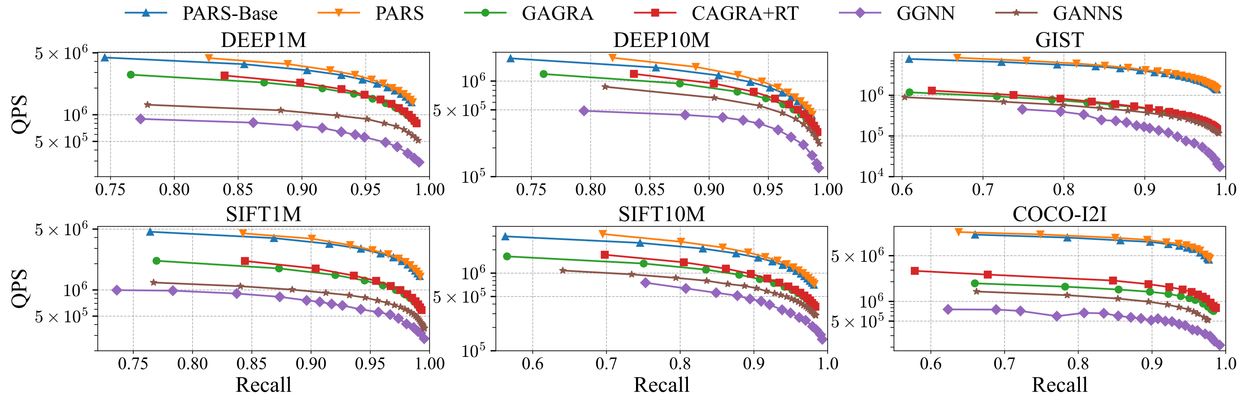
QPS-Recall
PARS significantly outperformed the baseline
Entry point selection strategy is effective
Notes:
- The QPS-recall curve shows the throughput of different methods at the same recall level. A curve closer to the upper-right corner means better accuracy and lower latency.
- We compare PARS with existing GPU-based graph search methods, including CAGRA, GGNN, and GANNS.
- [click] The results show that PARS and PARS-Base both clearly outperform the baselines.
- [click] For example, at about ninety-eight percent recall on the SIFT ten million dataset, PARS achieves one point nine nine times, four point three four times, and two point four three times higher query throughput than CAGRA, GGNN, and GANNS.
- Also, PARS outperforms PARS-Base, and CAGRA+RT outperforms CAGRA. These results show that our entry-point selection strategy is effective.

Slide 21
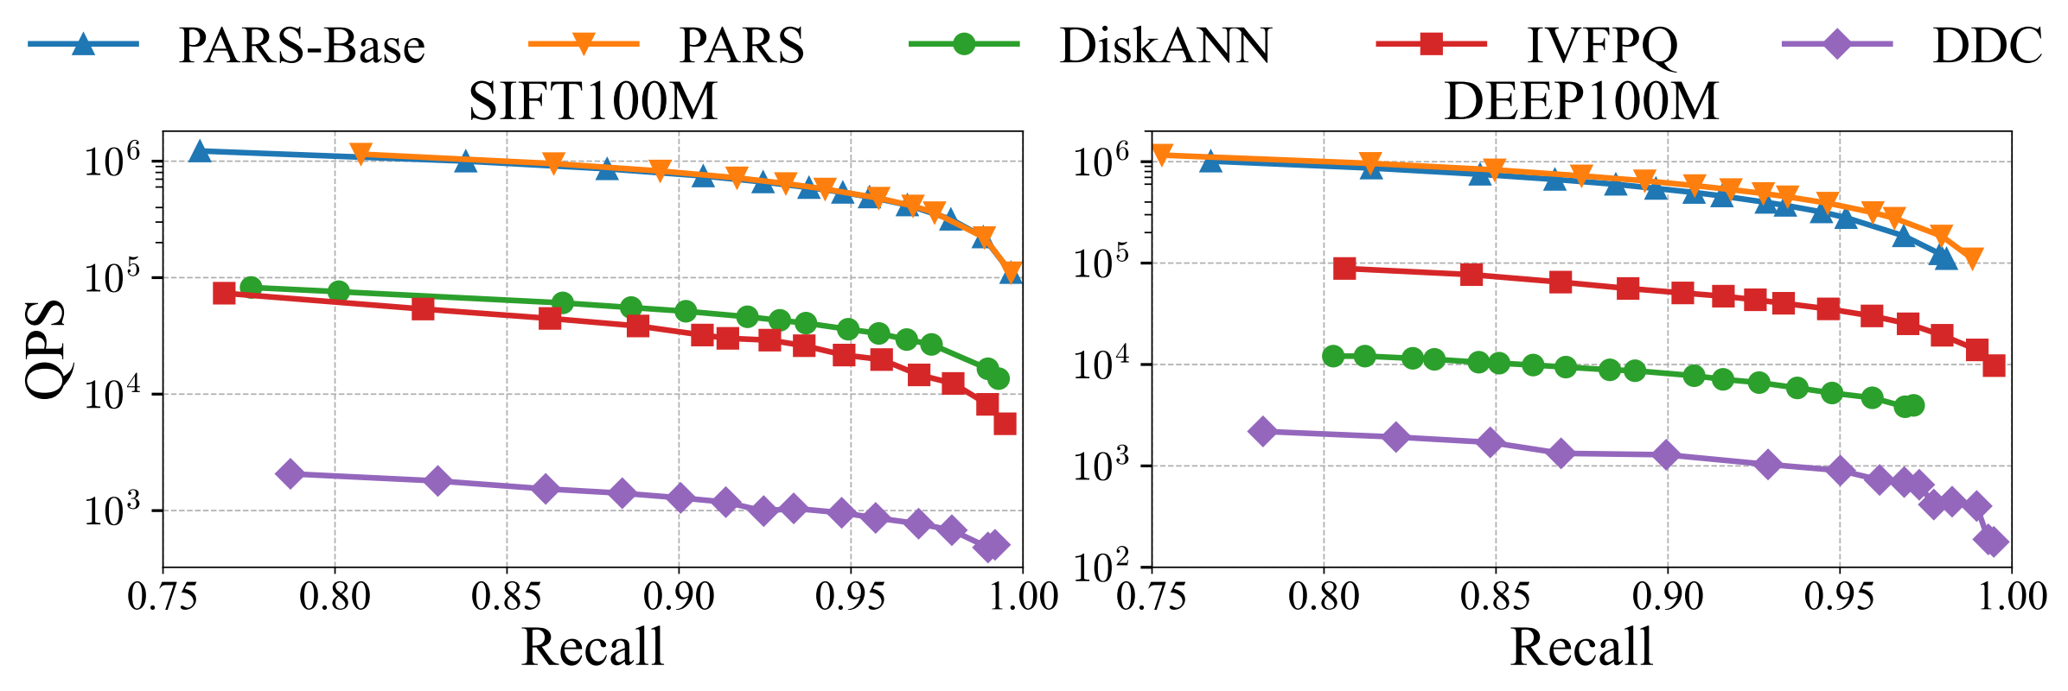
Results on Larger Datasets
On 100M datasets, PARS achieves the best performance among all compared methods
Notes:
- To see whether PARS still works on larger datasets, we run experiments on a hundred million-scale dataset.
- At this scale, no GPU-based graph search method can currently run on a single GPU. So we compare PARS with CPU-based methods, including DiskANN and DDC, and with a GPU-based quantization method, IVFPQ.
- The results show that PARS achieves the best performance among all compared methods.

Slide 22
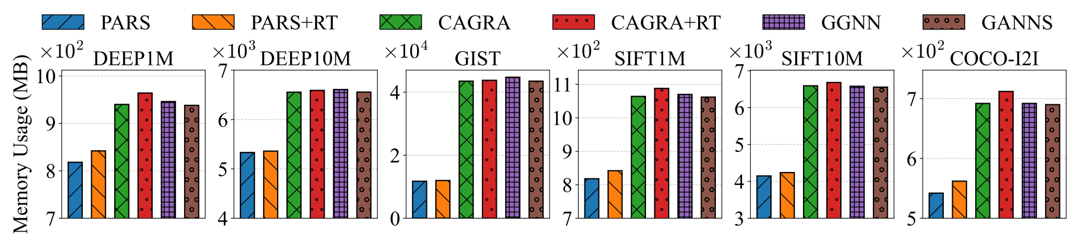
Memory Usage
It reduced by 37.07% on the SIFT1M dataset.
It reduced by 73.01% on the high-dimensional GIST dataset.
When the dimensions are compressed more aggressively and the dataset size increases, its advantage will be further amplified.
Notes:
- For memory use, PARS reduces GPU memory by thirty-seven percent on the SIFT one million dataset and [click] by seventy three percent on the GIST dataset.
- Moreover, [click] when the dimension is compressed more aggressively and the dataset becomes larger, this advantage becomes even stronger.

Slide 23
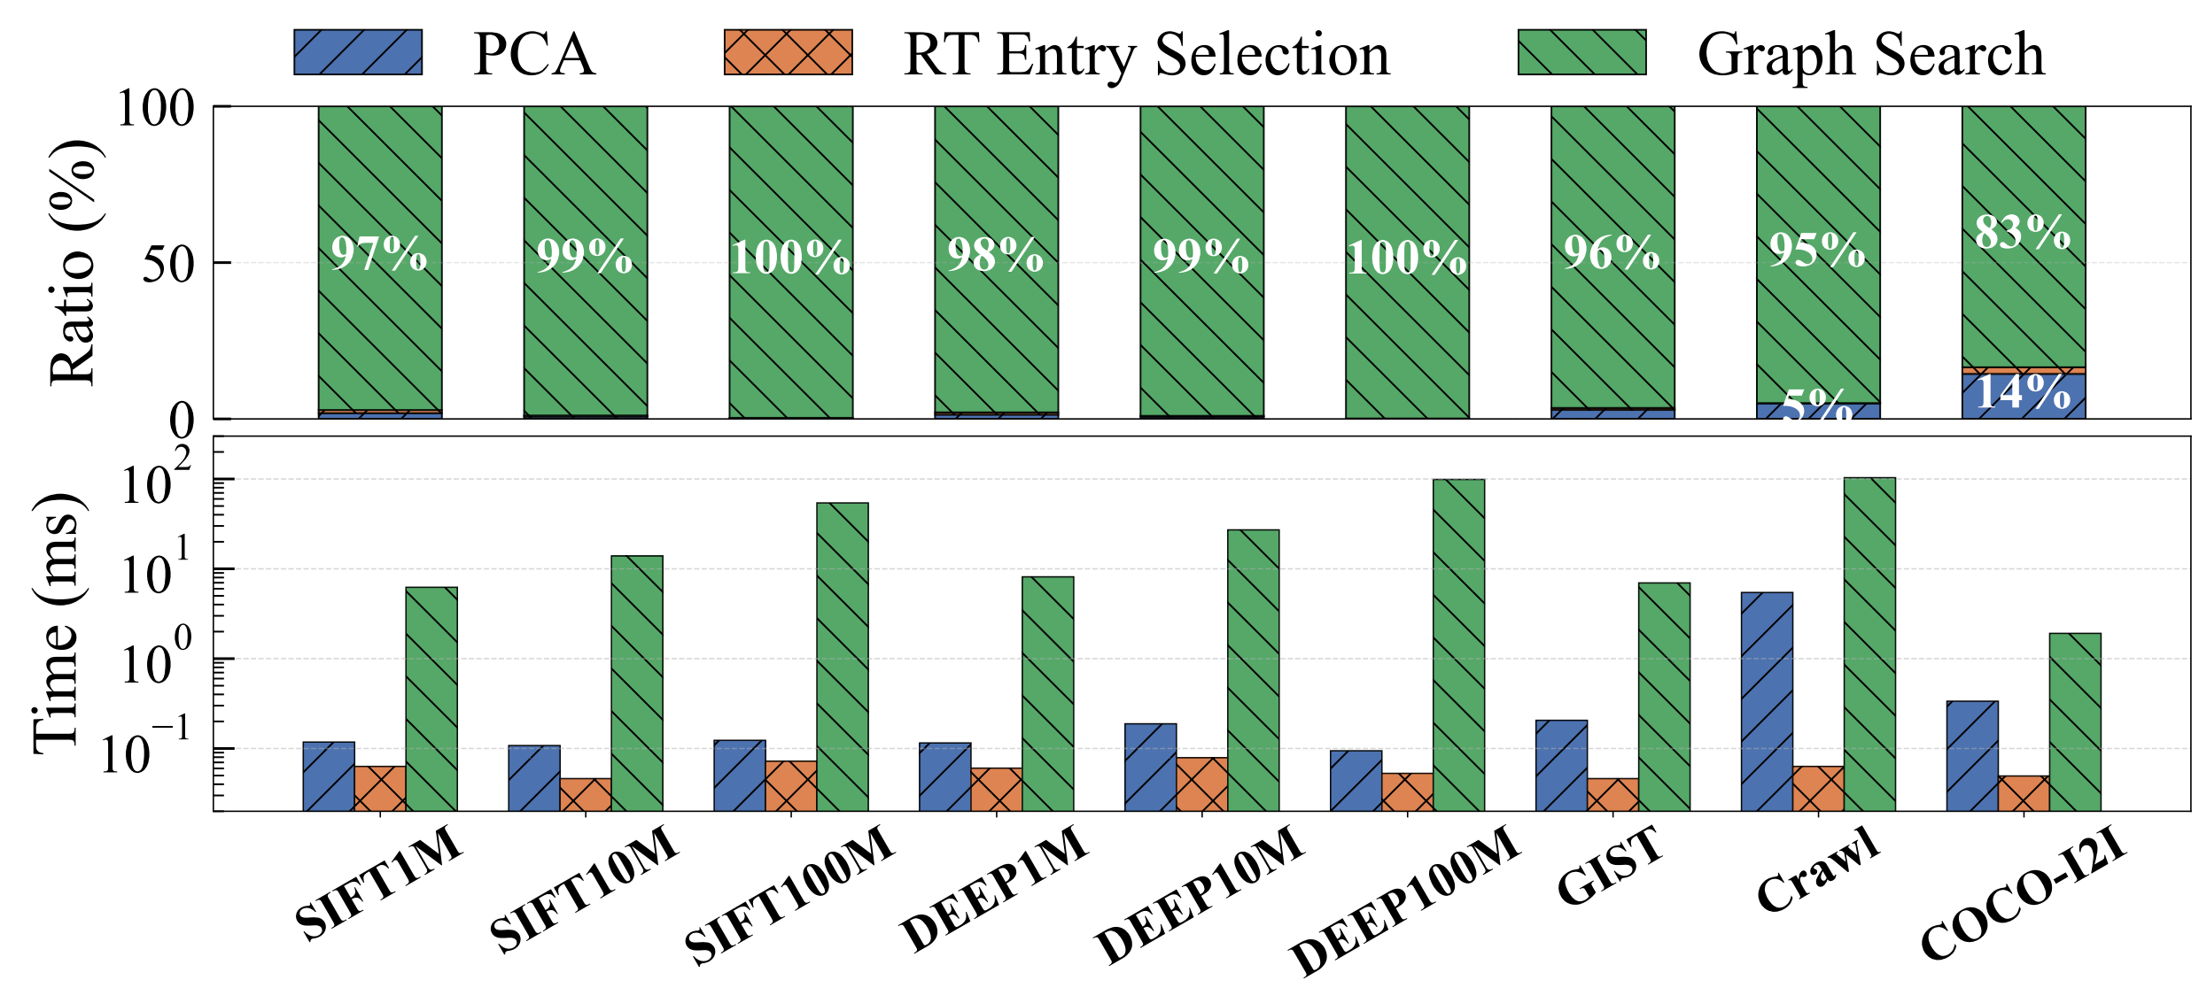
Runtime Breakdown
Most computation lies in graph traversal
Entry-point selection is extremely lightweight
Notes:
- The search process of PARS has three main parts: PCA transformation of the query vector, RT-based entry point search, and graph-based search.
- Among these parts, graph search takes almost all of the query time. The RT-based entry point search only takes a very small part.
- This means our lightweight entry-point selection strategy can be added to other graph search algorithms with very low computation cost.

Slide 24
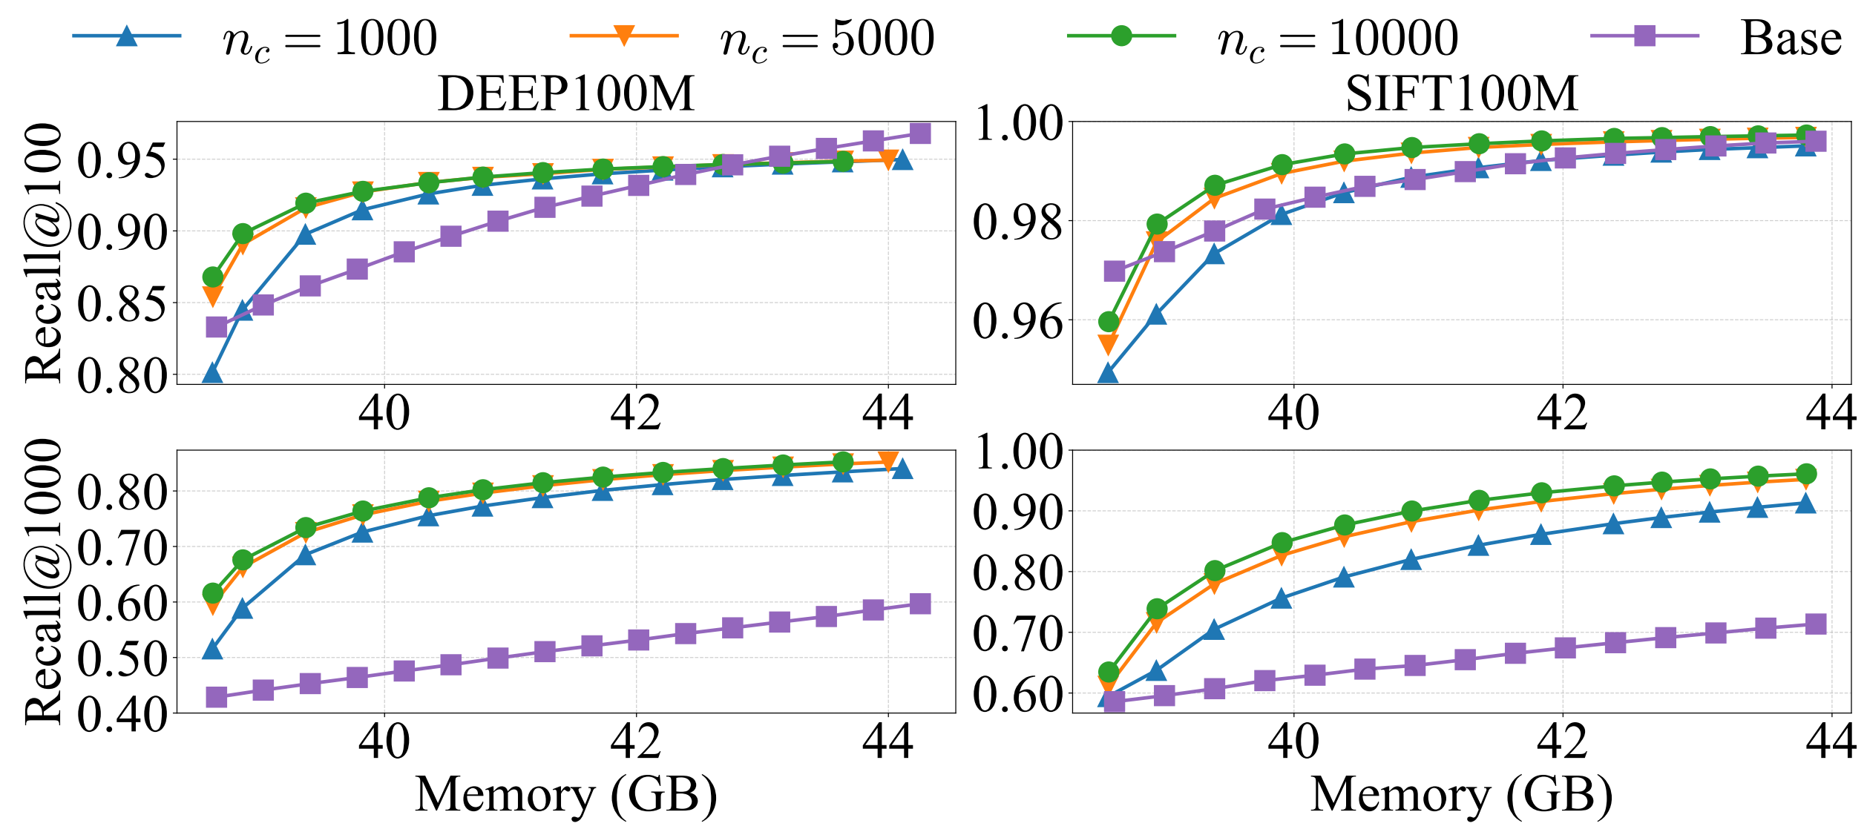
Twin-buffer
Twin-buffer
Non-twin-buffer
Low accuracy requirements
High accuracy requirements
Low-accuracy: buffer-free sufficient
High-accuracy: twin-buffer improves recall
Notes:
- To evaluate the twin-buffer mechanism, we compare it with a baseline without twin-buffer [click].
- For the non-twin-buffer setting, we control memory use by changing the number of computed dimensions.
- For the twin-buffer setting, we fix the dimension of all remaining data points. Then we adjust memory use by changing the buffer size.
- The results show that:
- [click] When the accuracy requirement is low, the system without twin-buffer can already achieve good performance.
- [click] But when the accuracy requirement is high, twin-buffer greatly improves recall under the same memory budget.

Slide 25
Conclusion
Problem:
  Redundant vector dimensions waste memory, bandwidth, and computation
PARS:
  Select dimensions via sampling and PCA reduction
  Use top-3 PCA dimensions for entry search, accelerated by RT cores
  Compensate for dimensionality reduction loss using a twin-buffer
Notes:
- To conclude, we analyze the limitations of existing approximate nearest neighbor search methods. Redundant vector dimensions waste memory, bandwidth, and computation.
- [click] To address these problems, PARS uses dimensionality reduction.
- First, we reduce the data dimension through sampling and PCA.
- [click] Next, we use the first three reduced dimensions to choose entry points. We speed up this step with RT Core.
- [click] Finally, we introduce a twin-buffer mechanism to make up for the accuracy loss caused by dimensionality reduction.

Slide 26
Thanks!
Email: ma10@mail.sdu.edu.cn
Notes:
Thank you for your attention. I’m happy to take your questions.
You can also contact me by email. Thank you.

